Slide 1
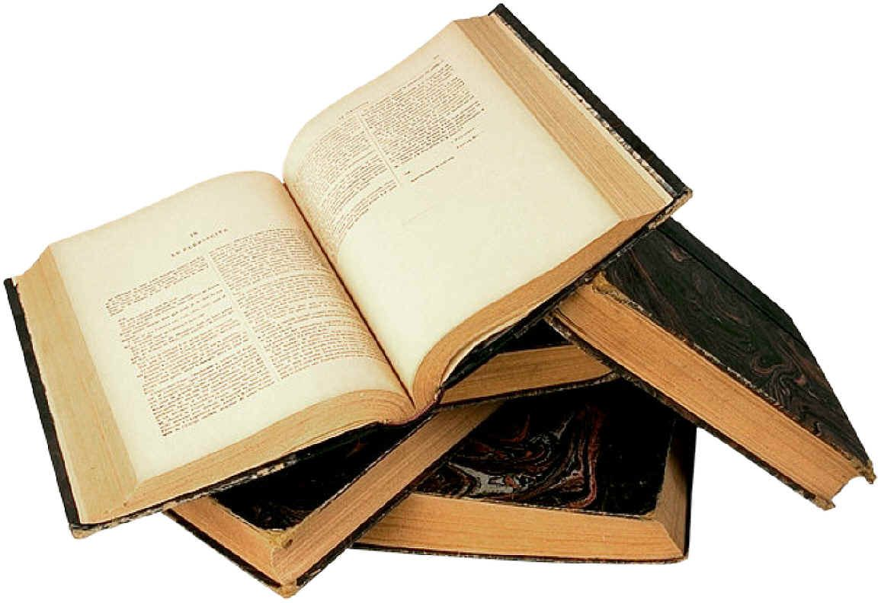
کتابهای خریداری شده بهمن ماه 1392
تهیه و تنظیم : فاطمه مستاجر
New books 1392

Slide 2
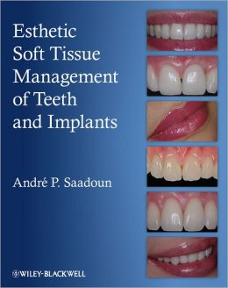
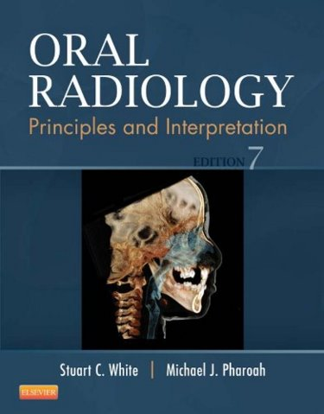
Esthetic soft tissue management of teeth and implants / André P. Saadoun 2013
New books 1392

Slide 3
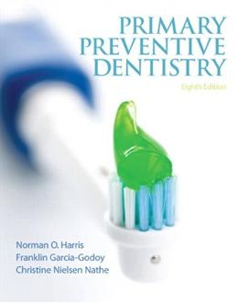
Primary preventive dentistry / [edited by] Norman O. Harris 2014
New books 1392

Slide 4
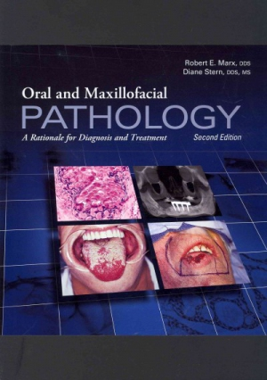
Oral and maxillofacial pathology / Robert E. Marx 2012
New books 1392

Slide 5
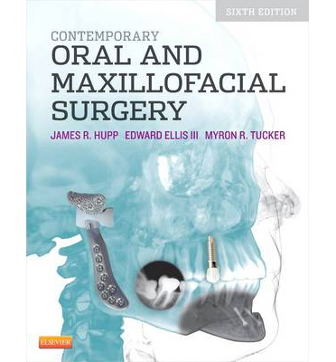
Contemporary oral and maxillofacial surgery / James R. Hupp 2014
New books 1392

Slide 6
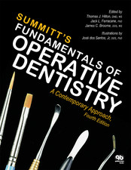
Fundamentals of Operative Dentistry / Summitt’s 2014
New books 1392

Slide 7
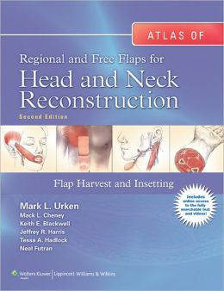
Atlas of regional and free flaps for head and neck reconstruction / Mark L. Urken 2012
New books 1392

Slide 8
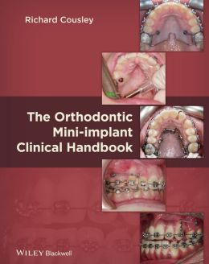
The orthodontic mini-implant clinical handbook / Richard R.J. Cousley 2013
New books 1392

Slide 9
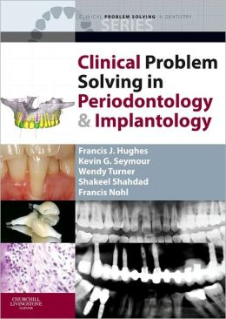
Clinical problem solving in periodontology & implantology / Francis J. Hughes 2013
New books 1392

Slide 10
Esthetic soft tissue management of teeth and implants / André P. Saadoun 2013
New books 1392

